Slide 1


INSTACAMPUS: SMART AUTOMATION SYSTEM
Group Members
Yash Jadhav(67)
Abhishek Pathak(68)
Ajay Yedge(69)
Guide Name: Prof.Hima Kantharia

Slide 2
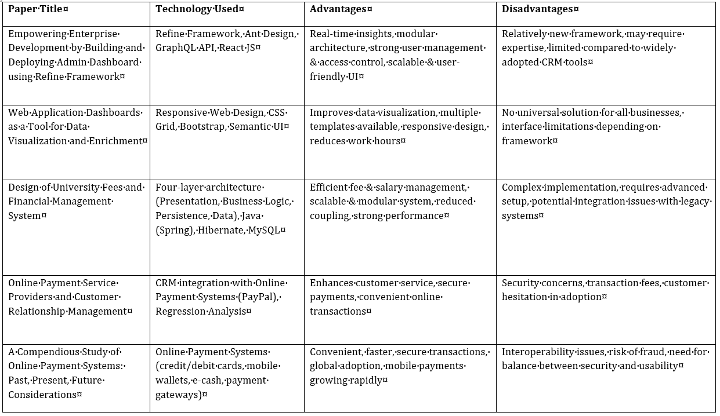
Literature Survey Table no.-1

Slide 3
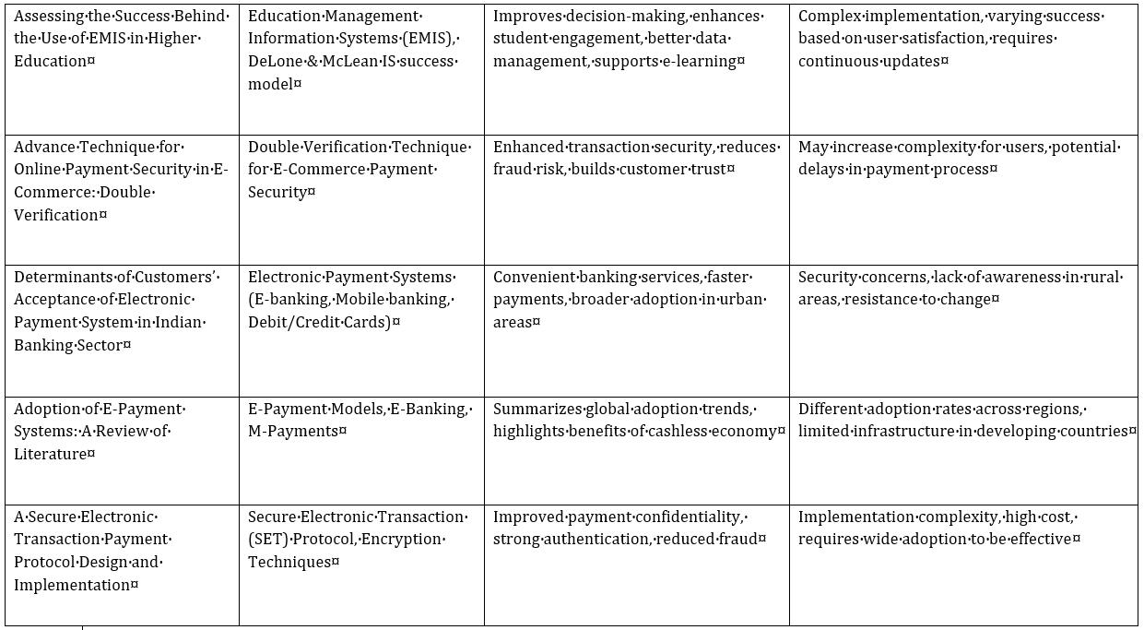
Literature Survey Table no:-2

Slide 4
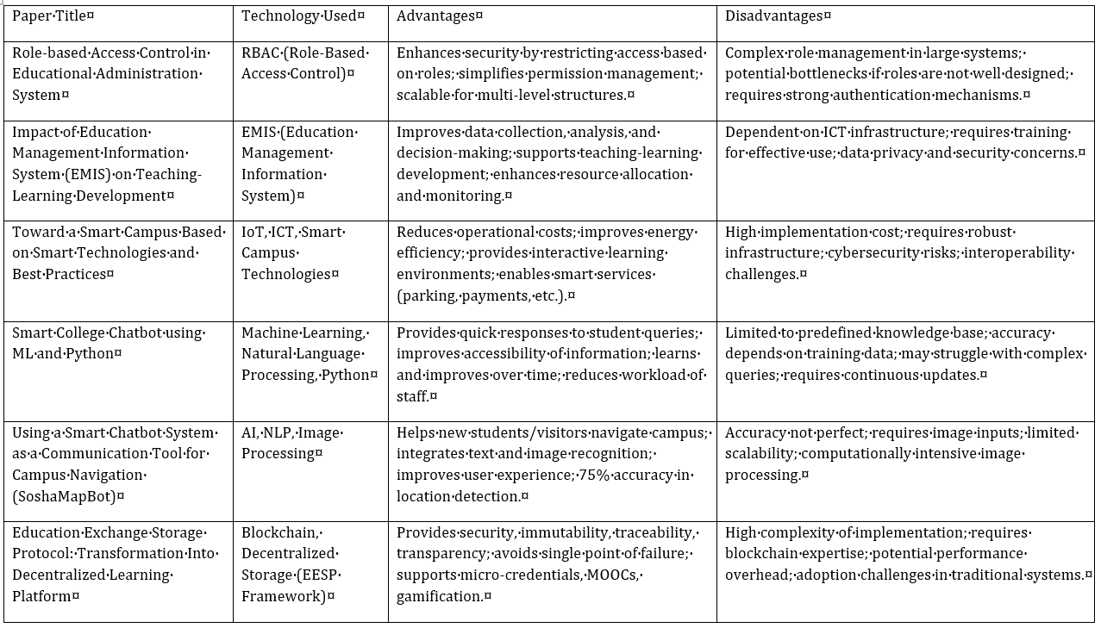
Literature Survey Table no.-3

Slide 5
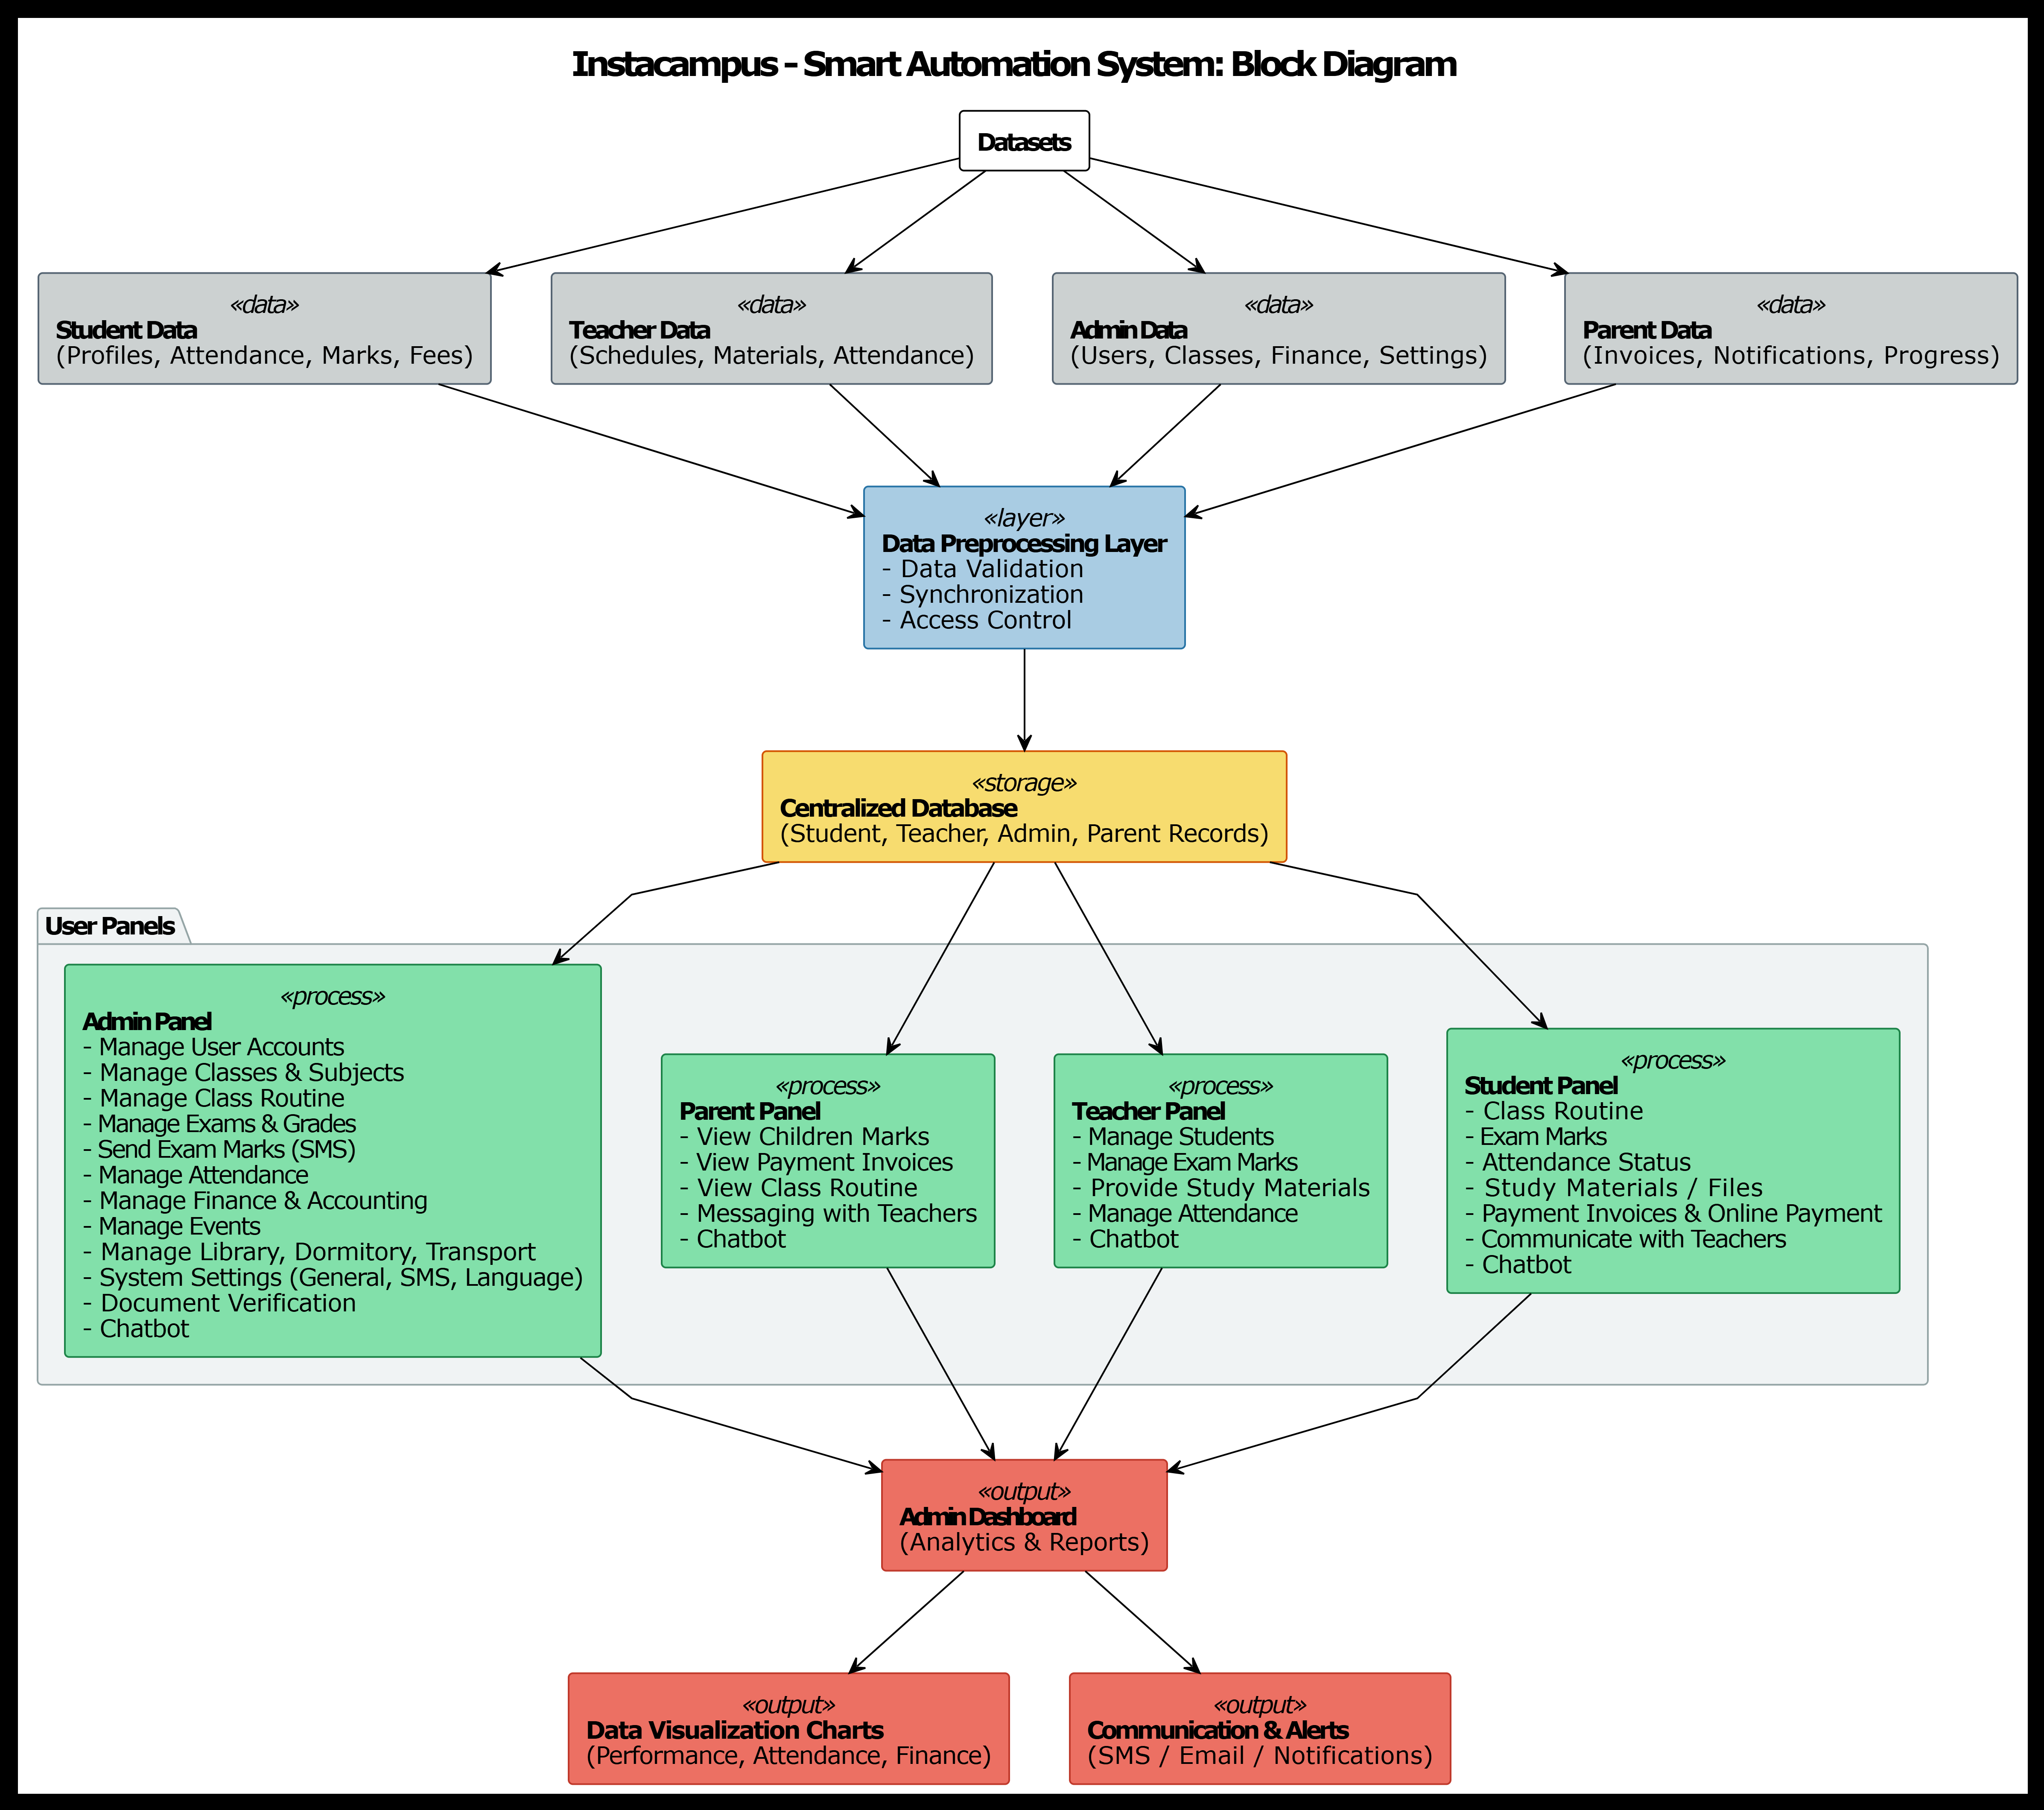
Block Diagram of system

Slide 6
Hardware/Software Requirements
Hardware Requirements :
Software Requirements :
Specification | Minimum
CPU | Quad-core Intel i5 / AMD Ryzen 5
RAM | 8GB
STORAGE | 256 GB SSD
GPU | NVIDIA GPU with 4 GB VRAM (e.g., GTX 1650)
OS | Windows 10 / Ubuntu 20.04
Category | Tools
Operating System | Windows 10/11, Ubuntu 20.04/22.04, or macOS
Frontend | HTML5, CSS3, JavaScript , Bootstrap / Tailwind CSS
Backend | PHP/PYTHON,MYSQL

Slide 7
References
[1] Sai Teja Gajjala, Devi Deepak Manchala, Bhargav Gummadelly, Naga Sailaja K. (2024). Empowering Enterprise Development by Building and Deploying Admin Dashboard using Refine Framework. arXiv preprint.
[2] Web Application Dashboards as a Tool for Data Visualization and Enrichment. (Research article / conference paper). (Authors & venue in the paper).
[3] S. Ye (or corresponding authors). (2025). Design of University Fees and Financial Management System. Proceedings (ACM).
[4] Alan D. Smith. (2008). Online Payment Service Providers and Customer Relationship Management. International Journal of Electronic Finance (Inderscience)
[5] B. Khan, R. F. Olanrewaju, et al. (Year). A Compendious Study of Online Payment Systems: Past Developments, Present Impact, and Future Considerations. (Survey paper).
[6] M. Alias, A. Zainuddin, & N. A. Wahab. (2018). Assessing the Success Behind the Use of EMIS in Higher Education Using DeLone & McLean IS Success Model.
[7] S. B. Gupta & A. Nath. (2017). Advance Technique for Online Payment Security in E-Commerce: Double Verification. International Journal of Computer Science and Information Security, 15(8), 256–261.

Slide 8
References
[8] R. Singh & P. Malhotra. (2019). Determinants of Customers’ Acceptance of Electronic Payment System in Indian Banking Sector. International Journal of Bank Marketing, 37(5), 1230–1252.
[9] G. A. Ajzen & T. P. Choudhury. (2020). Adoption of E-Payment Systems: A Review of Literature. Journal of Business and Management Review, 11(2), 45–58.
[10] M. S. Hwang & C. C. Lee. (2016). A Secure Electronic Transaction Payment Protocol: Design and Implementation. International Journal of Network Security, 18(6), 1125–1135.
[11] A. Al-Mamary, A. Shamsuddin, & N. A. Aziati. (2014). Role-based Access Control in Educational Administration System. International Journal of Computer Applications, 86(6), 1–6.
[12] K. Tarus & P. Gichoya. (2015). Impact of Education Management Information System (EMIS) on Teaching-Learning Development. International Journal of Education and Development using ICT, 11(2), 101–114
[13] H. Yang, S. Shen, & J. Chen. (2019). Toward a Smart Campus Based on Smart Technologies and Best Practices. IEEE Access, 7, 72071–72084
[14] P. Jain & R. Kumar. (2021). Smart College Chatbot Using Machine Learning and Python. International Journal of Advanced Research in Computer Science, 12(4), 45–50.

Slide 9
References
[15] M. Chatterjee, A. Dey, & S. Saha. (2022). Using a Smart Chatbot System as a Communication Tool for Campus Navigation (SoshaMapBot). Procedia Computer Science, 192, 2340–2347.
[16] Y. Li, X. Zhang, & W. Huang. (2020). Education Exchange Storage Protocol: Transformation into Decentralized Learning Platform Using Blockchain. Journal of Network and Computer Applications, 168, 102738

